Slide 1
PERSONAL LOAN
JAVA PROJECT
BATCH:- SDA-FSD-01-02
SESSION 2022-23
GROUP MEMBERS:-
Akshay Shinde.
Shambhu Aher.
Swapnil Waghule.
Vaibhav Dagade. Guide By:-
Amit Darade. Mr.Raj Kolhe.
Kunal Patil.
By TEAM DEMONS…

Slide 2
INDEX
What is personal Loan?
Flow Chart.
Benefits.
Criteria.
Loan EMI Calculator.
Conclusion.

Slide 3
PERSONAL LOAN
Loans that matter..

Slide 4
PERSONAL LOAN

Slide 5
What is personal Loan?
Personal Loan is an unsecured credit provided by financial institutions based on criteria like employment history, repayment capacity, income level, profession and credit history.

Slide 6
FlowChart.

Slide 7
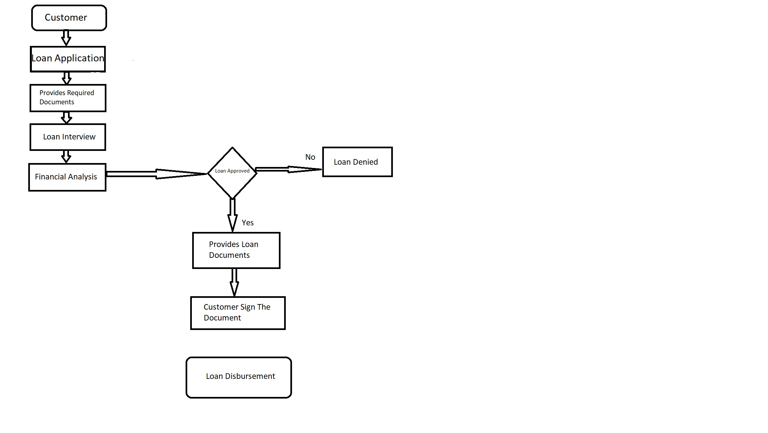

Slide 8

Benefits

Slide 9
Benefits
Minimum Documents.
Approval Process is Quick.
Loan Amount Is Disbursement Within a Few Hours.

Slide 10

Criteria.

Slide 11
Criteria.
Over 18 years old and a resident of India.
Salaried Individual, having a regular monthly income of 30,000+
Having a good CIBIL Score.

Slide 12

Loan EMI Calculator

Slide 13
Loan EMI Calculator
The mathematical formula for calculating EMI is as follows: EMI = [P x R x (1+R)^N]/[(1+R)^N-1]
Where, “P” stands for Principal Loan Amount, “R” stands for Rate of Interest (per month) or annual ROI divided by 12 “N” stands for Loan Tenure (in months)
The EMI amount may vary at the time of loan disbursement; depending upon the date of disbursal and period between the disbursal date and the first EMI date.

Slide 14
Conclusion.
A loan might not always be a good sign but at times might be required.
Being transparent with family and choosing the best option is the Personal Loan.

Slide 15
Thanks…!

